Slide 1
Lecture 10 Introduction to Zybo, Vivado, Lab #4
Pulse Amplitude Modulation 4 (PAM4)
Xilinx vs. Altera (Intel)
Prerequisites and Platform Support
Hardware and Software Codesign with Zynq
The Zynq-7000 AP SoC Chip architecture
The Zybo Board and Zynq 7000 Chip
Xilinx University Program: Embedded Systems Development using Zynq
The First Five Labs from Xilinx University Program: Embedded Systems Development using Zynq
Altera’s Cyclone V SoC
Lab #4: ZYNQ1-1 to 1-16 and ZYNQ2-1 to 2-16

Slide 2
References
ZYBO Reference Manual, 2014 (pdf)
The Zynq Book (pdf)
Zynq-7000 All Programmable SoC, Technical Reference Manual, 2015
Zynq-7000 All Programmable S
AMBA™ 3 APB Protocol Overview
7 Series FPGAs SelectIO Resources, User’s Guide, 2015
AXI Reference Guide, Xilinx, 2012

Slide 3
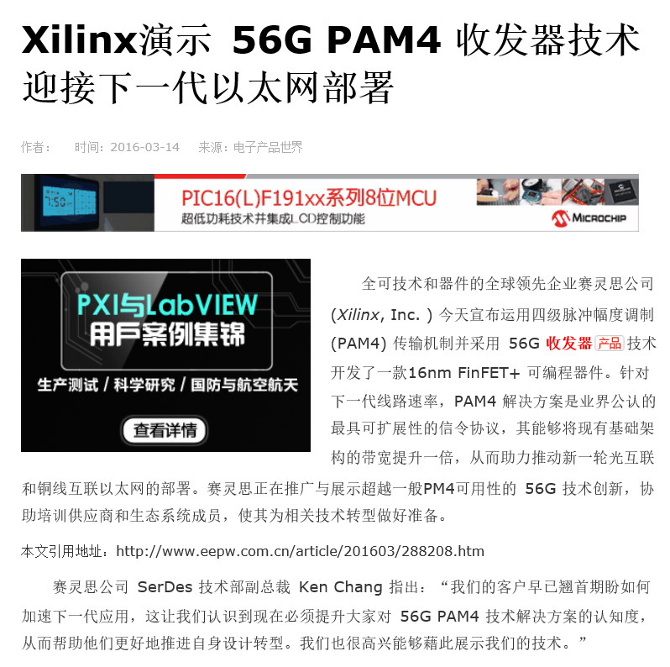
Xilinx video on PAM4: https://www.xilinx.com/products/technology/high-speed-serial/56g.html

Slide 4
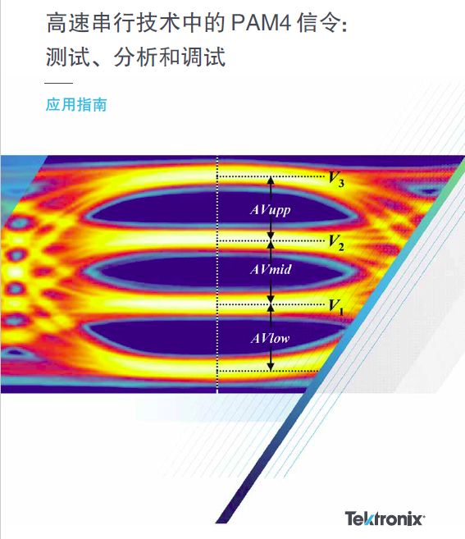
Xilinx video on PAM4: https://www.xilinx.com/products/technology/high-speed-serial/56g.html

Slide 5
56G PAM4 Technology
http://www.xilinx.com/products/technology/high-speed-serial/56g.html
Breaks through the physical limitations of data transmission at 50G+ line rates
PAM4 Modulation as the Way Forward
PAM4 (or 4-level Pulse Amplitude Modulation) has been recognized as the most scalable multi-level signaling protocol for next-generation line rates, and Xilinx is helping drive 56G PAM4 standardization efforts within both the Optical Internetworking Forum (OIF) and the Institute of Electrical and Electronics Engineers (IEEE).
Paving the Way Forward for Next Generation Ethernet
Cloud Computing, Industrial IoT, and Software-Defined Networks applications
Scale 50G, 100G, 400G ports, as well as terabit interfaces

Slide 6
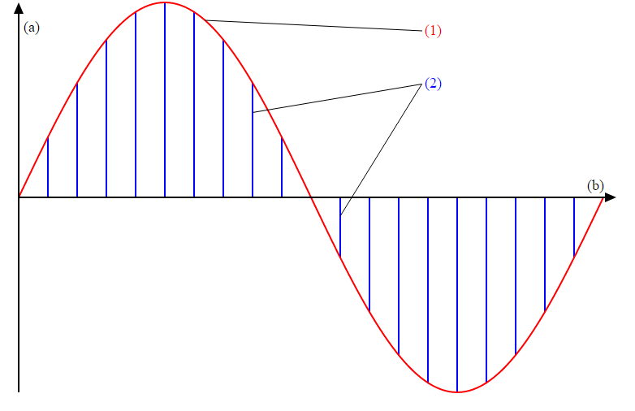
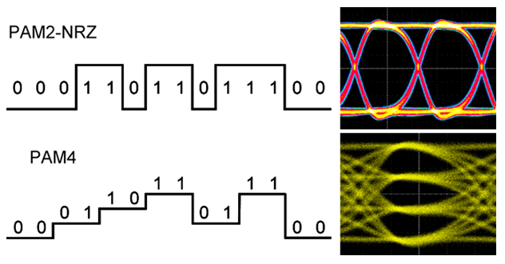
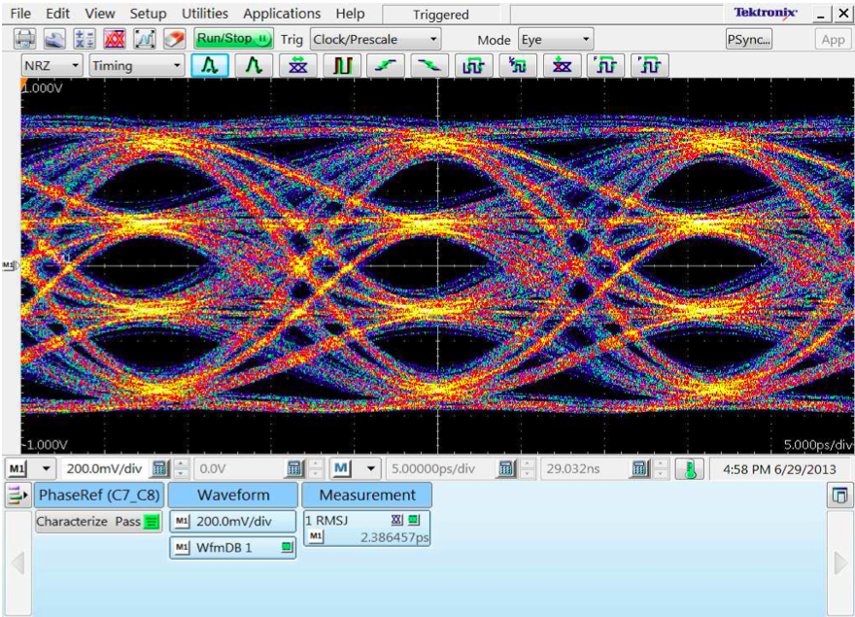
PAM 4
PAM 4 Signal generated on AWG6020 with 72 GS/s Sample rate.
Tektronix
http://www.tek.com/blog/time-get-ready-pam4
Four levels on the eye diagram
http://globaltek.us.com/products/southern-photonics-awg34g/awg3420/

Slide 7
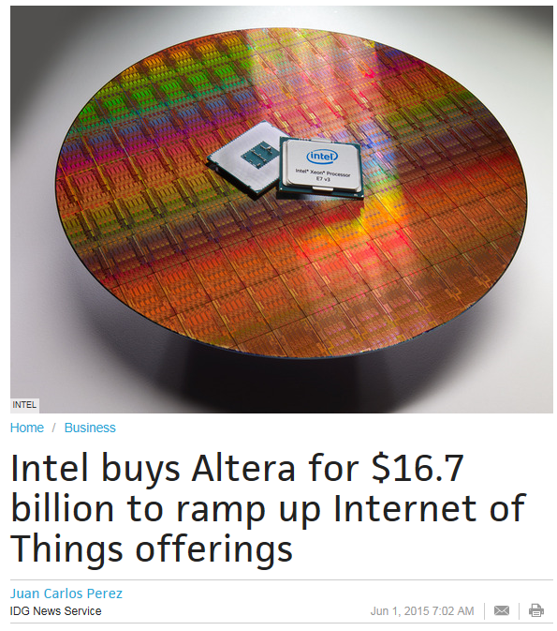
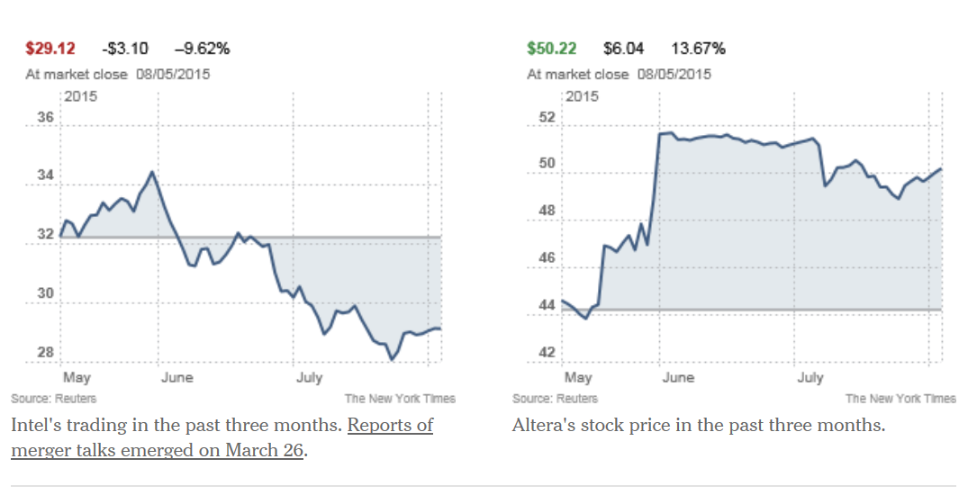
Intel buys Altera
June 1, 2015
Altera is Number 2 FPGA company in USA after Xilinx

Slide 8
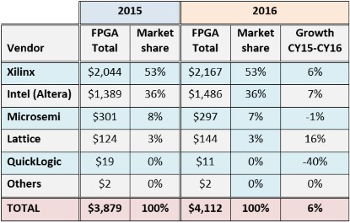
Top FPGA Companies For 2015-16
https://www.eetimes.com/author.asp?doc_id=1331443

Slide 9
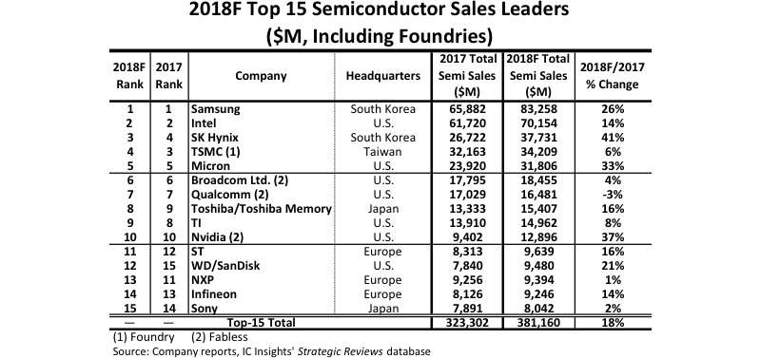
Top Semiconductor Companies in the World in 2018
https://www.eetimes.com/document.asp?doc_id=1334017&_mc=RSS_EET_EDT&utm_source=newsletter&utm_campaign=link&utm_medium=EETimesMCU-20181204

Slide 10
Objectives
Introduce Xilinx Zybo Zynq-7000 ARM/FPGA SoC Trainer Board, Rev B
Introduce Xilinx Vivado Design Suite
Introduce Software Development Kit (SDK)
Introduce Concept of System on a Chip (SoC)
Introduce Hardware and Software Co-design
Create SoC embedded systems to utilize FPGA and ARM co-design
Linux Solution on Zynq-7000 All Programmable SoC

Slide 11
Prerequisites and Platform Support
Familiarity with the Xilinx tool set and design flow
Basic C programming
Basic understanding of processor-based system
Basic Verilog HDL knowledge
Vivado System Edition 2015.2
Xilinx University board – Zybo
Linux

Slide 12
Distinct Features of Hardware and Software Design
 | Hardware | Software
Design Paradigm | Decomposition in space | Decomposition in time
Resource | Area (#gates, #Slices) | Time (#Cycles)
Flexibility | Must be designed in | Implicit
Parallelism | Implicit | Must be designed in
Modeling | Model ≠ Implementation | Model ≈ Implementation
Reuse | Uncommon | Common
Adapted from ECE699 Course Slides
Prepared by Prof. Kris Gaj of George Mason University

Slide 13
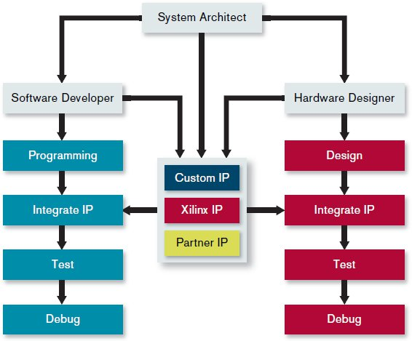
System Design Flow
Software
Hardware
Xilinx: Creating the Xilinx Zynq-7000 Extensible Processing Platform
© Copyright 2014 Xilinx
Notes:
The Zynq-7000 Extensible Processing Platform relies on a familiar tool flow for system architects, software developers as well as hardware designers.

Slide 14
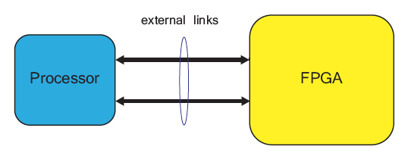
Traditional Discrete Component Architecture
Source: The Zynq Book
© Copyright 2014 Xilinx

Slide 15
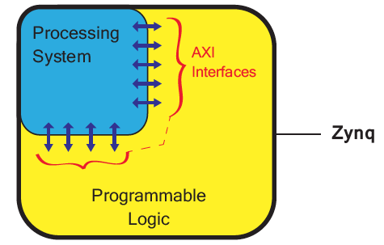
System on a Chip: the Zynq Chip Architecture
Source: The Zynq Book
© Copyright 2014 Xilinx

Slide 16
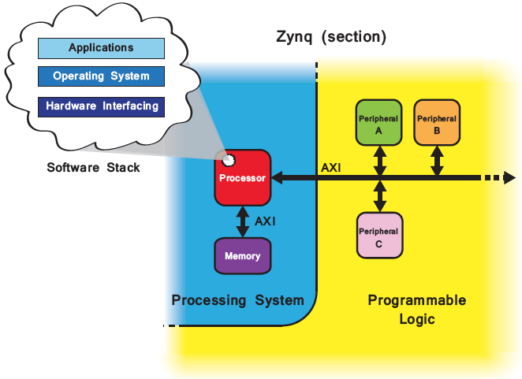
Mapping of an Embedded SoC Hardware Architecture to Zynq
Source: The Zynq Book
© Copyright 2014 Xilinx

Slide 17
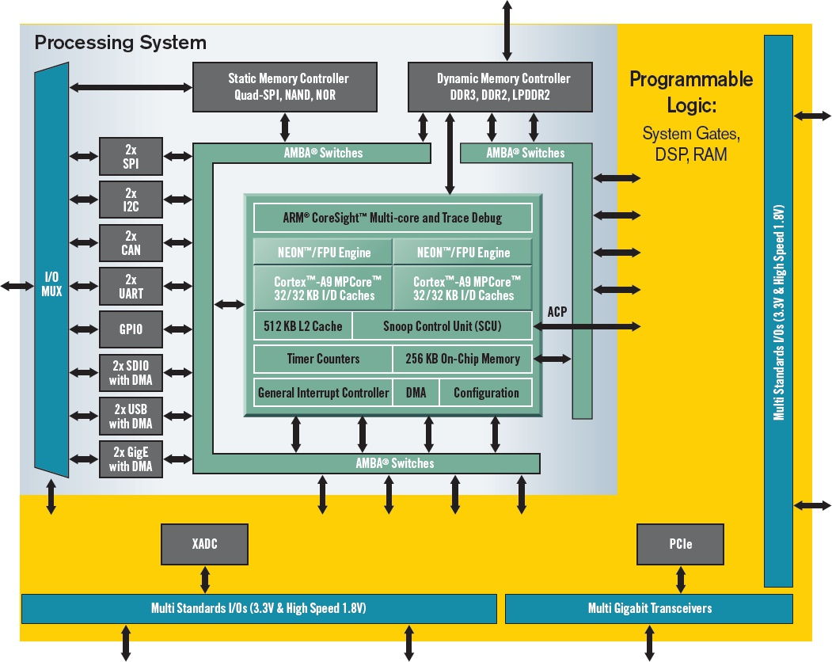
Mapping of an Embedded SoC Hardware Architecture to Zynq
Xilinx: Creating the Xilinx Zynq-7000 Extensible Processing Platform
© Copyright 2014 Xilinx
Notes:
Figure 1. Unlike previous chips that combine MPUs in an FPGA fabric, Xilinx’s new Zynq-7000 Extensible Processing Platform device family lets the ARM processor, rather than the programmable logic, run the show.

Slide 18
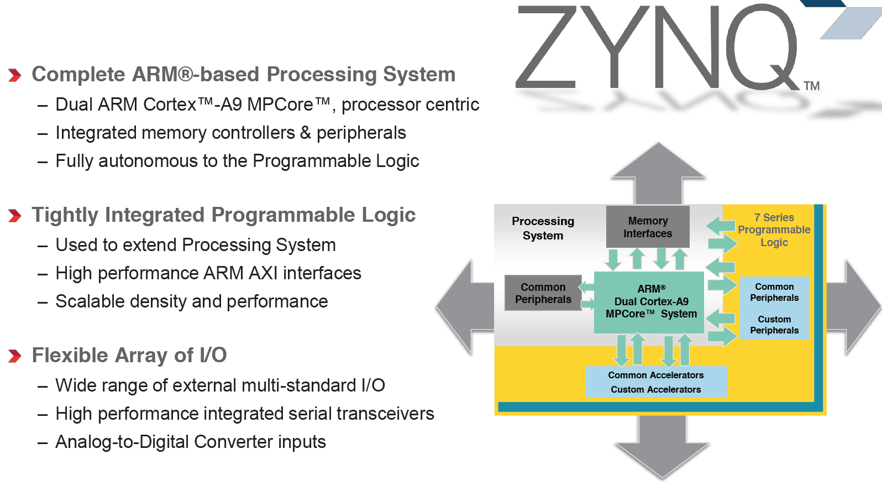
Zynq Highlights
Source: Xilinx Video Tutorials
© Copyright 2014 Xilinx

Slide 19
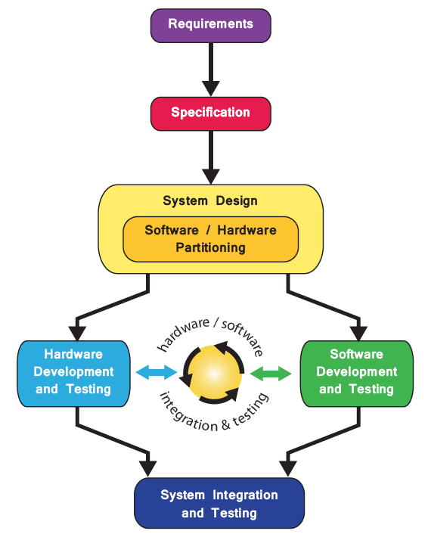
Basic Design Flow for Zynq SoC
© Copyright 2014 Xilinx
Source: the Zynq Book

Slide 20
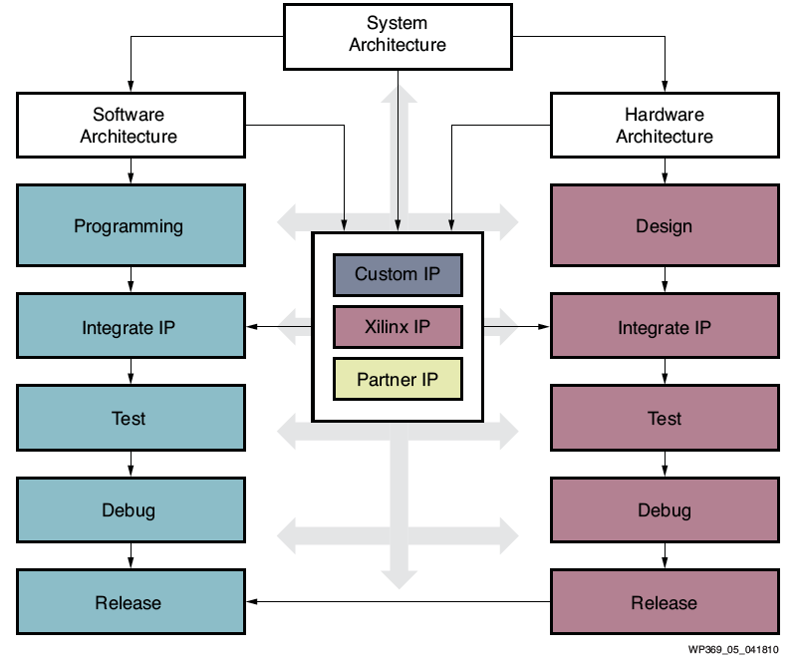
Design Flow for Zynq SoC
Source: Xilinx White Paper: Extensible Processing Platform
© Copyright 2014 Xilinx

Slide 21
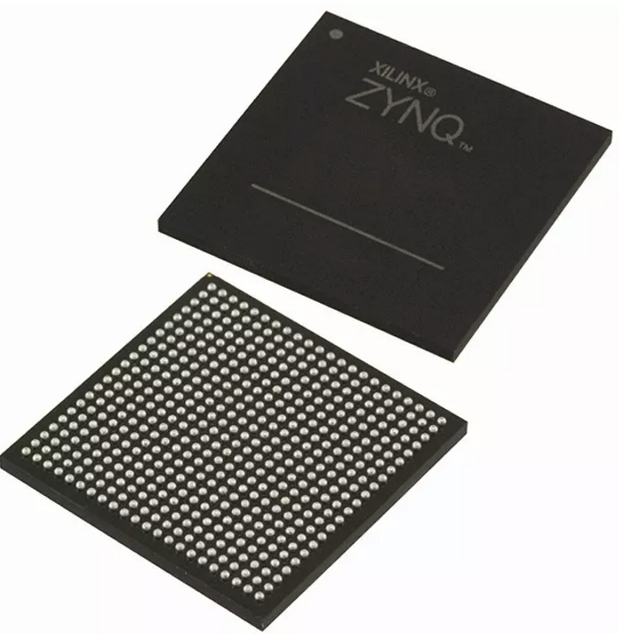
Embedded Design Architecture in Zynq
Processor and peripherals
Dual ARM® Cortex™ -A9 processors of Zynq-7000 AP SoC
AXI interconnect
AXI component peripherals
Reset, clocking, debug ports
Software platform for processing system
Bare Metal Applications or OS’s (e.g. Linux, FreeRTOS)
C language support
Processor services
C drivers for hardware
User application
Interrupt service routines (optional)

Slide 22
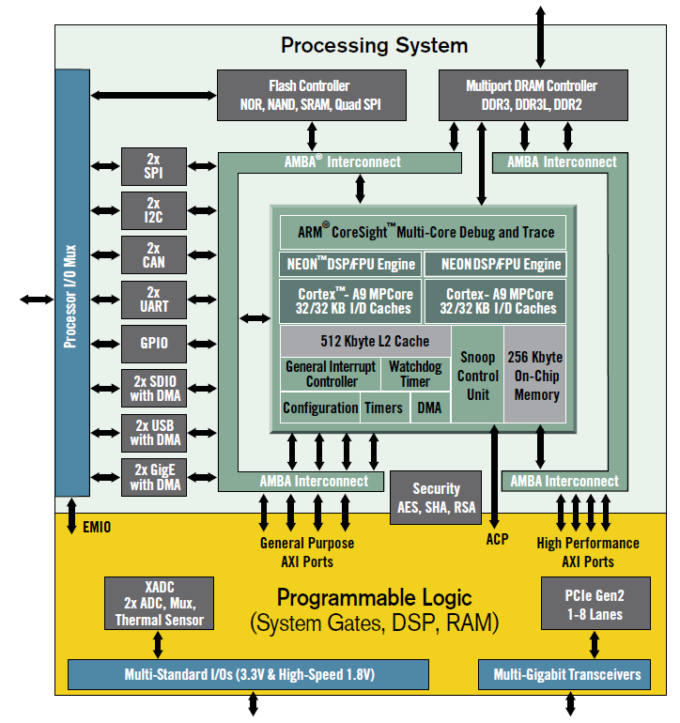
The Zynq-7000 AP SoC Chip Architecture
Up to 1GHz, dual-core, ARM Cortex-A9 MPCore microprocessor
On-Chip memory controllers
Peripherals
ARM AMBA AXI-based interconnect
Programmable Logic

Slide 23
Zynq-7000 SoC: Processing System and Programmable Logic
Processing System (PS)
Dual-core ARM® Cortex™-A9 MPCore™ with CoreSight™ up to 1GHz
Dynamic Memory interface (DMI): DDR3, DDR3L, DDR2, LPDDR2
High Speed Peripherals: USB 2.0, Gigabit Ethernet, SD/SDIO
Timers: Public and private
General interrupt controller (GIC)
On-chip memory (OCM): ROM and RAM
Debug controller: CoreSight
Programmable Logic (PL)
Max Logic Cells/ System Logic Cells (K): 444
Max Memory (Mb): 26.5
Max DSP Slices: 2,020
Max I/O Pins: 250

Slide 24
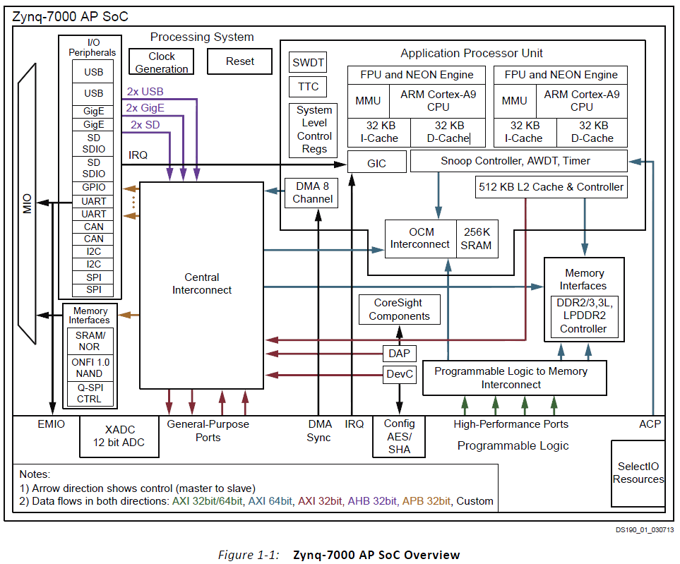
The Zynq AP SoC Processing System
PS
APU
Memory
Peripherals
MIO
PL
Artix®-7
CLBs
BRAM
DSP
XADC
CMT
SelectIO
Page 27, ug585-Zynq-7000-TRM

Slide 25
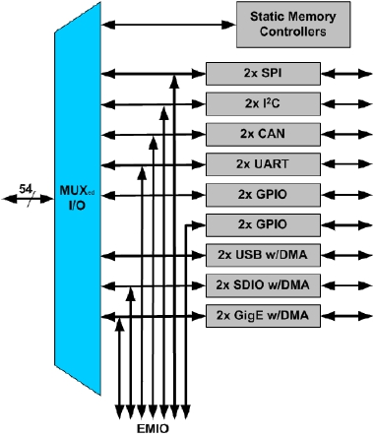
Zynq Architecture Built-in Peripherals
Two USB 2.0 OTG/Device/Host
OTG: On-The-Go
Two Tri- Mode GigE (10/100/1000)
GigE: Gigabit Ethernet
Two SD(Secure Digit) /SDIO interfaces
Memory, I/O and combo cards
Two CAN 2.0Bs, SPIs , I2Cs, UARTs
Four GPIO 32bit Blocks
54 available through MIO; other available through EMIO
Multiplexed Input/Output (MIO)
Multiplexed pinout of peripherals and static memories
Extended MIO (EMIO)
Maps PS peripheral ports to the PL

Slide 26
Processing System (PS): ZYNQ XC7Z010-1CLG400C Chip
ARM Cortex-A9 processor , 650MHz
Single and double precision Vector Floating Point Unit (VFPU)
Timer and Interrupts; Three watchdog timers
One global timer; Two triple-timer counters
Caches
32 KB Level 1 4-way set-associative instruction and data caches
512 KB 8-way set-associative Level 2 cache (shared between the CPUs)
On-Chip Memory
256 KB on-chip RAM (OCM), On-chip boot ROM
External Memory Interfaces
16-bit or 32-bit interfaces to DDR3, DDR3L, DDR2, or LPDDR2 memories
1GB of address space using single rank of 8-, 16-, or 32-bit-wide
8-bit SRAM data bus with up to 64 MB support
ug585-Zynq-7000-TRM

Slide 27
PS: ZYNQ XC7Z010-1CLG400C Chip
I/O Peripherals and Interfaces
Two 10/100/1000 tri-speed Ethernet MAC peripherals with
Two USB 2.0 OTG peripherals• Intel EHCI compliant USB host
Two full CAN 2.0B compliant CAN bus interfaces
Two SD/SDIO 2.0/MMC3.31 compliant controllers
Two full-duplex SPI ports with three peripheral chip selects
Two high-speed UARTs (up to 1 Mb/s)
Two master and slave I2C interfaces
GPIO with four 32-bit banks
up to 54 bits can be used with the PS I/O
up to 64 bits connected to the Programmable Logic
Up to 54 flexible multiplexed I/O (MIO) for peripheral pin assignments
Interconnect
High-bandwidth connectivity within PS and between PS and PL
ARM AMBA® AXI based
ug585-Zynq-7000-TRM

Slide 28
Programmable Logic (PL): Artix-7 FPGA
450MHz Internal Clock
Configurable Logic Blocks (CLB)
28K Logic Cells, 17,600 Look-up tables (LUT); 35,200 Flip-flops; Cascadeable adders
240 Kb Block RAM
80 DSP Blocks
18 x 25 signed multiply; 48-bit adder/accumulator; 25-bit pre-adder
Programmable I/O Blocks
Supports LVCMOS, LVDS, and SSTL; 1.2V to 3.3V I/O
Serial Transceivers
Up to 16 receivers and transmitters; Supports up to 12.5 Gb/s data rates
Two 12-Bit Analog-to-Digital Converters
Up to 17 external differential input channels
One million samples per second maximum conversion rate
ug585-Zynq-7000-TRM

Slide 29
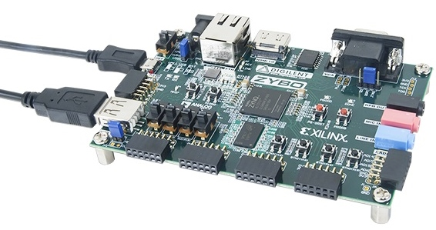
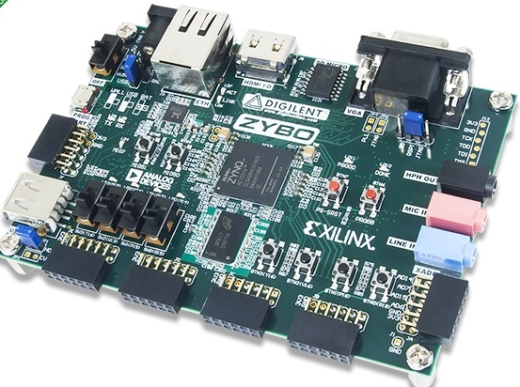
Zybo Zynq-7000 ARM/FPGA SoC Trainer Board
Digilent
$189
Voucher for Xilinx Vivado Design Suite: Design Edition (One full seat, node locked, device-locked to the Zynq-7000 XC7Z010)
4GB microSD card
Micro USB cable
5V 2.5A switching power supply

Slide 30
Resources on the Zybo Board
28,000 logic cells
40 KB Block RAM
80 DSP slices
On-chip dual channel, 12-bit, 1 MSPS analog-to-digital converter (XADC)
650 MHz dual-core Cortex™-A9 processor
On-board JTAG programming and UART to USB converter
DDR3 memory controller with 8 DMA channels
512 MB x32 DDR3 w/ 1050Mbps bandwidth
128 Mb Serial Flash w/ QSPI interface
microSD slot (supports Linux file system)
High-bandwidth peripheral controllers: 1G Ethernet, USB 2.0, SDIO

Slide 31
Resources on the Zybo Board
Low-bandwidth peripheral controller: SPI, UART, I2C
Dual-role (Source/Sink) HDMI port
16-bits per pixel VGA output port
Trimode (1Gbit/100Mbit/10Mbit) Ethernet PHY
OTG USB 2.0 PHY (supports host and device)
External EEPROM (programmed with 48-bit globally unique EUI-48/64™ compatible identifier)
Audio codec with headphone out, microphone and line in jacks
GPIO: 6 pushbuttons, 4 slide switches, 5 LEDs
Six Pmod connectors (1 processor-dedicated, 1 dual analog/digital)

Slide 32
Zynq 7000 Chip on Zybo Board
XC7Z010T-1CLG400 All Programmable SoC
The Zynq-7000 AP SoC architecture consists of two major sections
PS: Processing system
Dual ARM Cortex-A9 processor based
Multiple peripherals
Hard silicon core
PL: Programmable logic
Shares the same 7 series programmable logic as
Artix™-based devices: Z-7010, Z-7015, and Z-7020 (high-range I/O banks only)

Slide 33
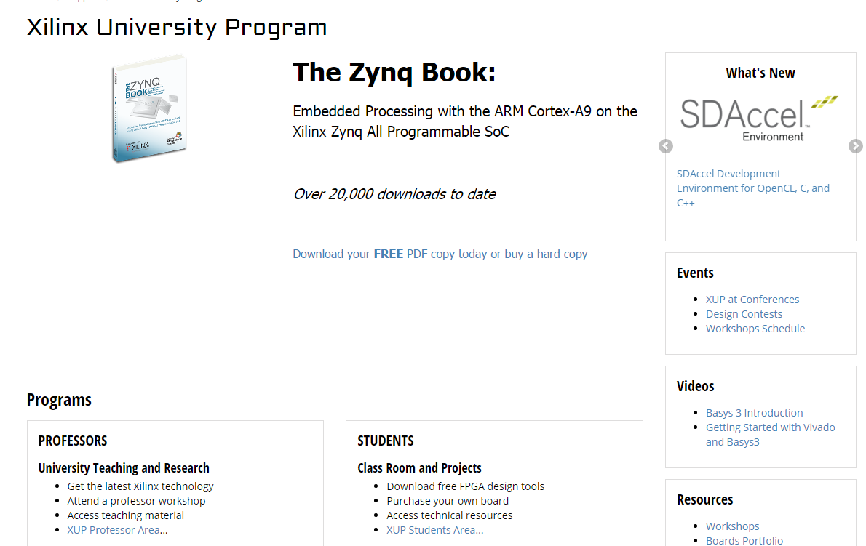
Xilinx University Program: Embedded Systems Development using Zynq
Notes:
The Xilinx University Program (XUP) enables academics to introduce and use Xilinx technologies in their curriculum and research. XUP collaborates with application expert academics to develop and deliver top-quality teaching materials. XUP also develops in-house workshop materials, teaching users how to use the tools and technologies in the most efficient ways. These workshop materials are accessible to academics to use in classes in their original forms and/or extend with additional material. XUP also gets actively involved in research projects where Xilinx FPGA technologies are utilized.

Slide 34
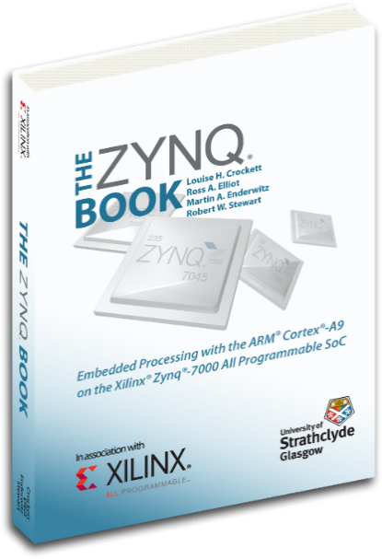
The First Five Labs: Embedded Systems Development using Zynq
From Xilinx University Program Website
Introduction to Embedded System Design using Zynq and Vivado
Lab 1: Simple Hardware Design
Zynq Architecture
Extending the Embedded System into PL
Lab 2: Adding IPs in Programmable Logic
Adding Your Own Peripheral
Lab 3: Creating and Adding Custom IP Software Development Environment
Lab 4: Writing Basic Software Applications
Software Development and Debugging
Lab 5: Software Debugging Using SDK

Slide 35
ARM Cortex-A9 based Embedded System Design: ZYNQ Lab1 through Lab5
Lab #4 of this class: ZYNQ Labs 1 and 2
Lab #5 of this class: ZYNQ Labs 3 and 4
Lab #6 of this class: ZYNQ Lab 5
ARM
Cortex-A9
PL
Memory
DDR3
Memory
Controller
Timer
RS232
UART
AXI
Interconnect
Block
AXI4
AXI-BRAM Controller
BRAM
AXI4-Lite
LED_IP
LED
M_AXI_GP0
AXI4-Lite
GPIO
Push-Buttons
PS
AXI4-Lite
GPIO
DIP Switches
Lab1
Lab2
Lab3
Lab5
Lab4 uses hardware built in Lab3
© Copyright 2015 Xilinx

Slide 36
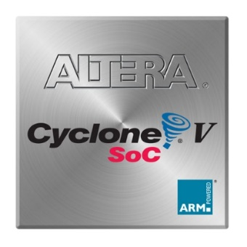
Intel Altera’s Cyclone V SoC Hard Processor System
925 MHz, dual-core ARM® Cortex™-A9 MPCore™ processor
32 KB of L1 instruction cache, 32 KB of L1 data cache
512 KB of shared L2 cache
64 KB of scratch RAM
Multiport SDRAM controller with support for DDR2, DDR3, and LPDDR2 and optional error correction code (ECC) support
8-channel direct memory access (DMA) controller
QSPI flash controller, NAND flash controller with DMA
SD/SDIO/MMC controller with DMA
2x 10/100/1000 Ethernet media access control (MAC) with DMA
2x USB On-The-Go (OTG) controller with DMA
4x I2C controller
2x UART

Slide 37

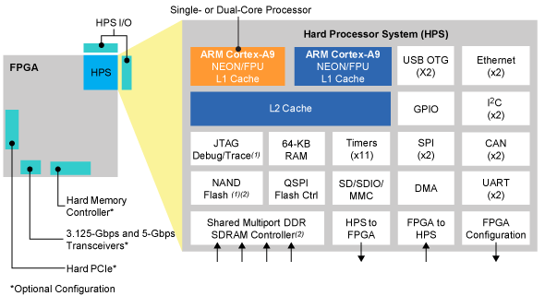
Altera’s Cyclone V SoC Hard Processor System
4x I2C controller
2x UART
2x serial peripheral interface (SPI) master peripherals, 2x SPI slave peripherals
Up to 134 general-purpose I/O (GPIO)
7x general-purpose timers
4x watchdog timers

Slide 38
Lab 4: ZYNQ Lab 1 and Lab 2
Lab #4 Part 1: ZYNQ Lab 1 Use Vivado to Build Embedded Systems, pages ZYNQ1-1 to ZYNQ1-16.
Lab #4 Part 2: ZYNQ Lab 2 Adding IP Cores in PL, pages ZYNQ2-1 to ZYNQ2-16.

Slide 39
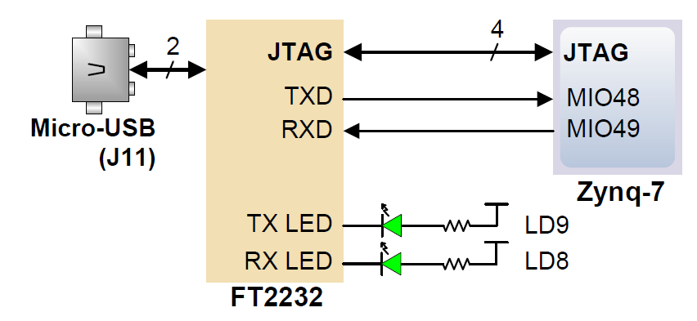
USB-UART Bridge on the Zybo Board
The board definition file takes care of mapping the correct MIO pins to the UART 1 controller and uses the following default protocol parameters: 115200 baud rate, 1 stop bit, no parity, 8-bit character length.
The FT2232HQ is also used as the controller for the Digilent USB-JTAG circuitry, but the USB-UART and USB-JTAG functions behave entirely independent of one another.

Slide 40
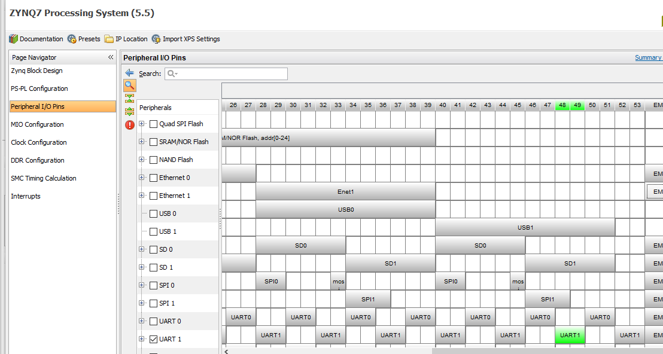
UART1 on MIO48 and MIO49

Slide 41
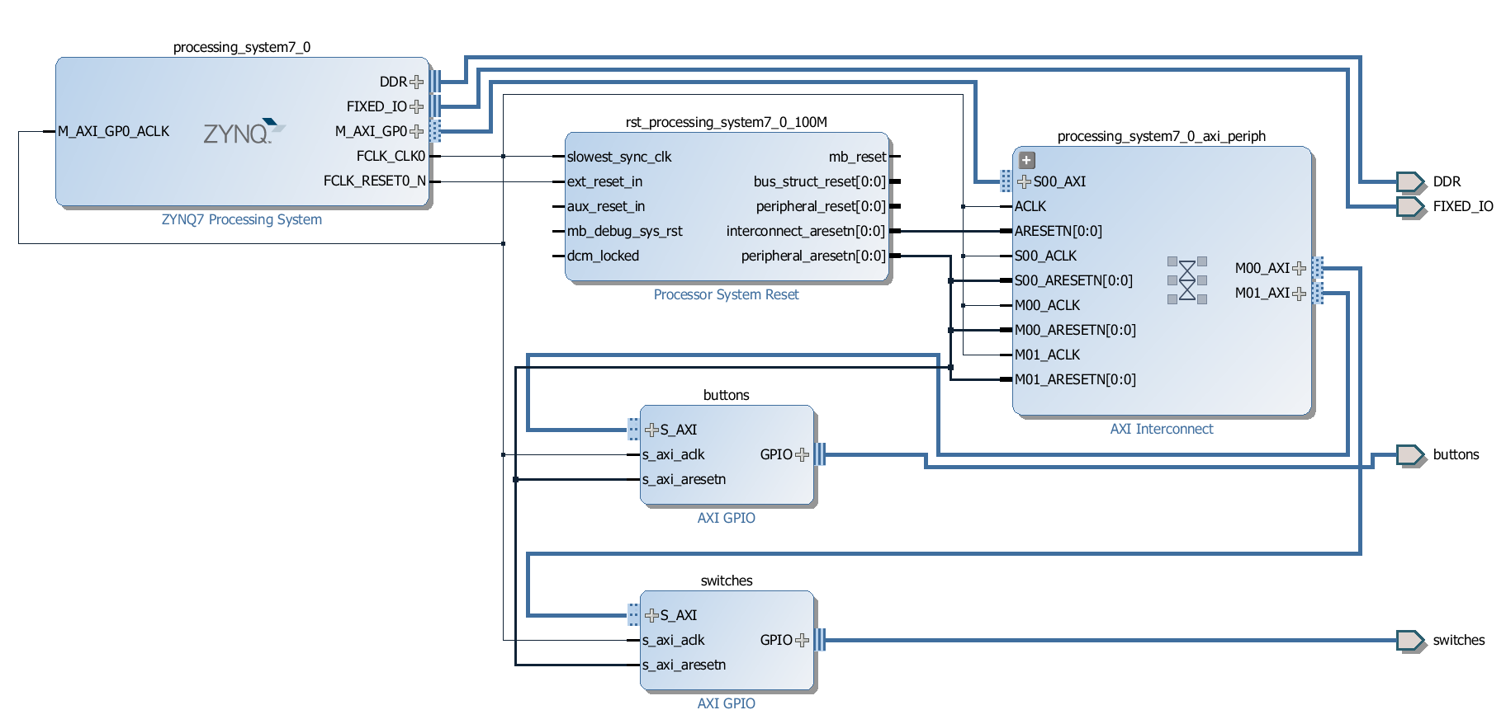
Lab #4 Part 1 and Part 2: Build a System and Add Soft IP Cores in PL
Lab #4 Part 1: ZYNQ1-16 Lab 1 to build a customized ARM embedded system
Lab #4 Part 2: ZYNQ2-16 Lab 2 to add soft IP cores in PL
AXI Interconnect Ports are IP cores
To connect ARM core, Zynq, to I/O pins for switches and buttons
AXI crossbar
switch soft cores
ARM hard core
EMIO pins
AXI interconnect
soft core
AXI interconnect
soft core
EMIO pins

Slide 42
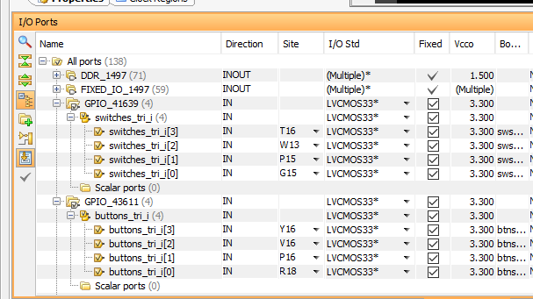
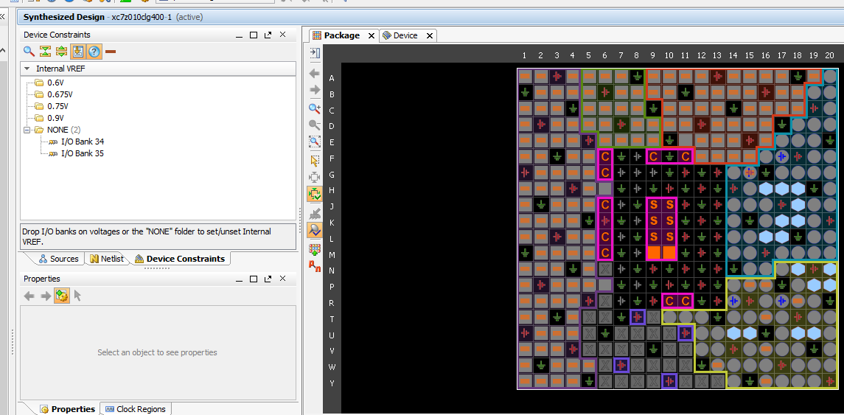
Lab #4 Part 2
Synthesized Design Window

